Slide 1

TaxPayer Documents
IRS Forms
&
TaxWise Software Input Forms

Slide 2
Agenda
Forms
  IRS W-2 Wage & Tax Statement
  IRS 1099INT, 1099DIV, 1099R, SSA-1099
Earned Income Credit & Child Tax Credit

Slide 3
W-2 Wage and Tax Statement
Employer issues to employee for tax year
Employer identification information
Employee identification information
Wages earned
Taxes withheld
All information to be copied to TaxWise EXACTLY as shown on the form
TaxWise puts information entered in proper place

Slide 4
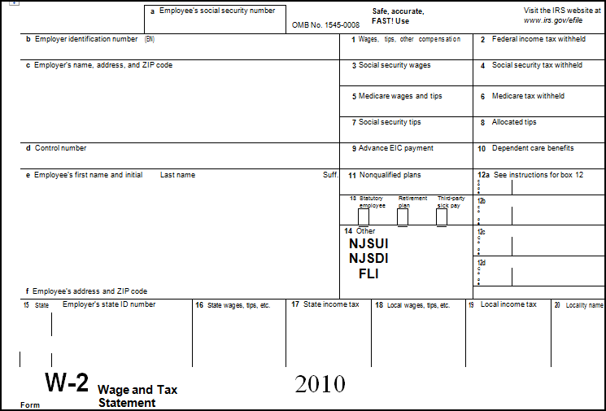
W-2 Wage & Tax Statement
Employer & Employee Info
Wage & Tax Info
Box-12 Copy to TaxWise – See Back of Form for Codes
State Wage & Tax Info
Checked Boxes
NJ Specific Taxes

Slide 5
1099-DIV, 1099-INT
Received from financial institution for dividends and/or interest received
Information from these forms are entered in TaxWise Schedule B Interest or Dividend Statement
TaxWise puts information into Schedule B Interest & Ordinary Dividends and then to 1040.

Slide 6
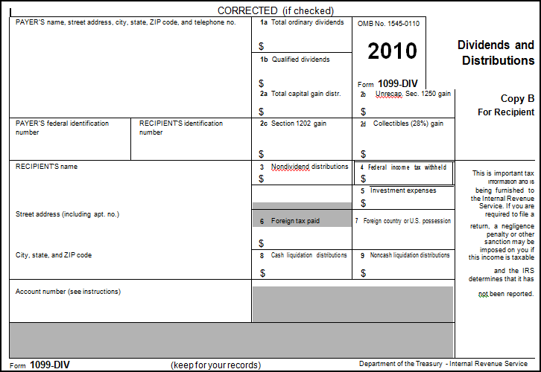
1099-DIV
Capital Gains Distribution
Qualified Dividends
Payer & Payee Information
Ordinary Dividends
Federal Taxes Withheld

Slide 7
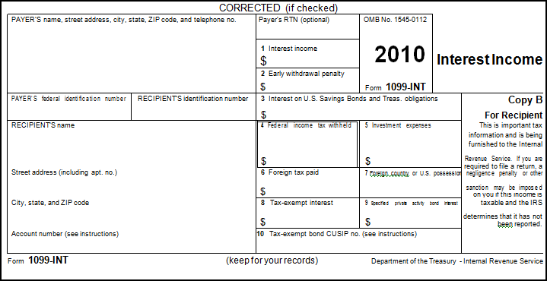
1099-INT
Interest Income
Payer & Payee Information
Early Withdrawal Penalty
Federal Income Tax Withheld

Slide 8
Interest & Dividend Worksheet
Information from the 1099-INT and 1099-DIV are entered in “Interest Stmt” and “Dividend Stmt” respectively in TaxWise.

Slide 9
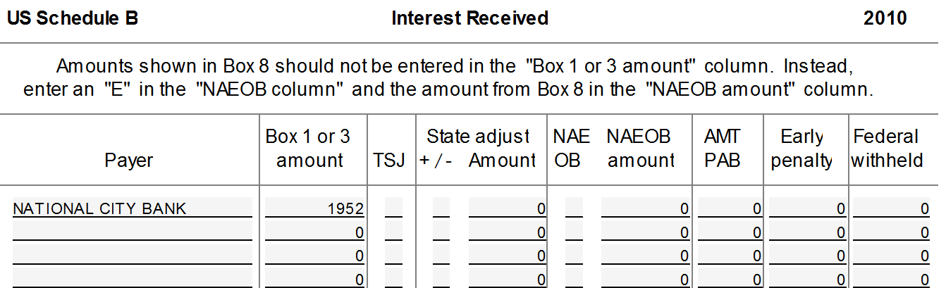
Interest Stmt

Slide 10
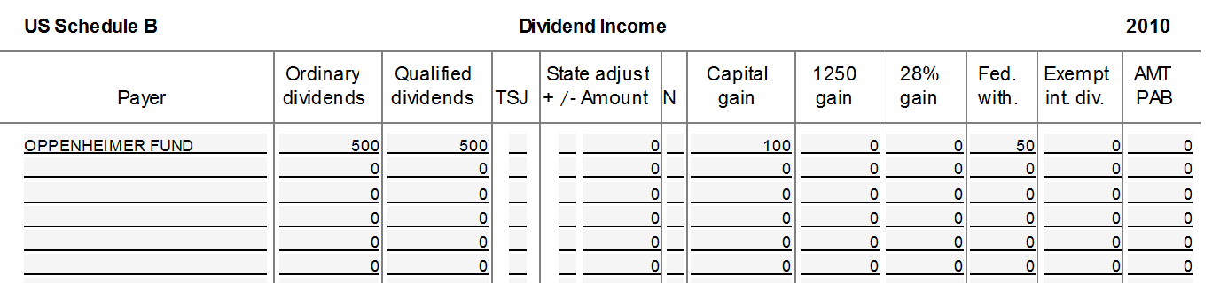
Dividend Stmt

Slide 11
1099-R
Distribution from pension, IRA, annuities, etc.
Enter information in TaxWise 1099R
TaxWise puts the proper information on the correct 1040 lines

Slide 12
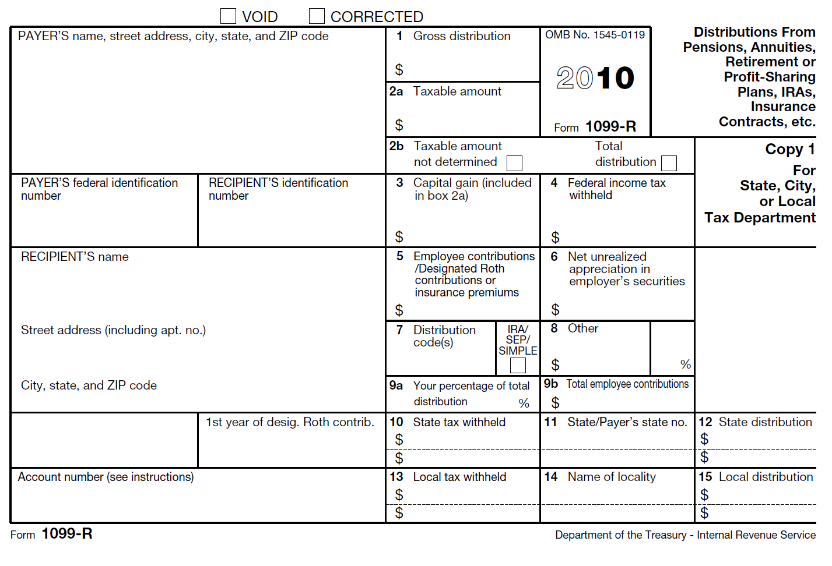
1099-R
If taxable amount not determined, there is more to do
Gross Distribution
Taxable Amount
Payer & Recipient Info
Checked if IRA
Distribution Codes defined on Back or in Help

Slide 13
SSA-1099
Social Security Distributions
Box 5 amount entered into TawWise 1040 Wkt 1
Medicare Part B entered into TaxWise 1040 Wkt 1
Box 6 Federal Income Tax Withheld into 1040 Wkt 1
Medicare Part D to Sch A Detail or Wkt 1 with scratch pad

Slide 14
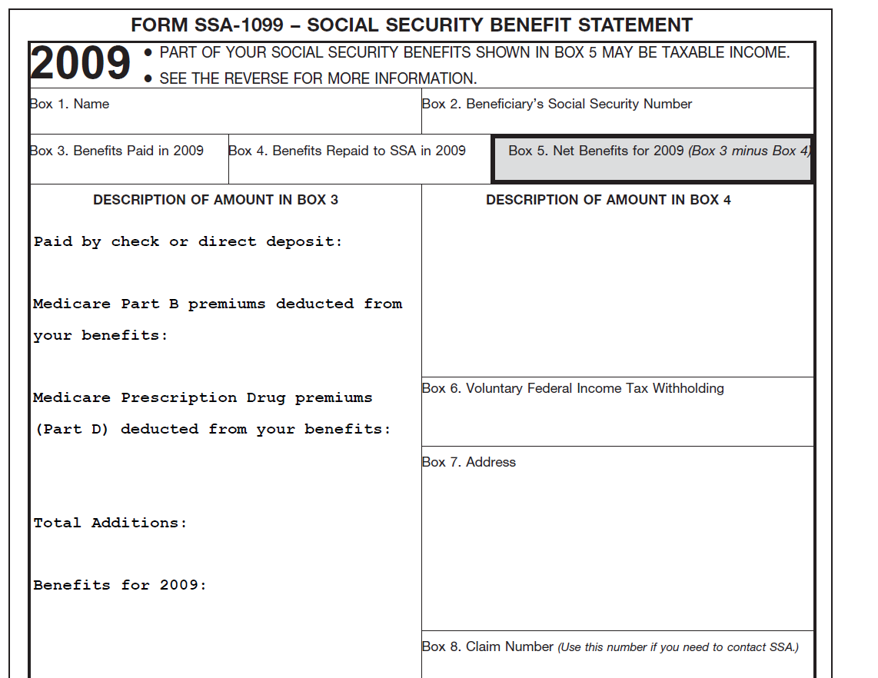
SSA-1099
Box 5 Amt to Wkt 1
Medicare Part B to Wkt 1
Federal Tax Withheld to Wkt 1
If there is Medicare Part D it is entered into Sch A Detail or Wkt 1 with scratch pad

Slide 15
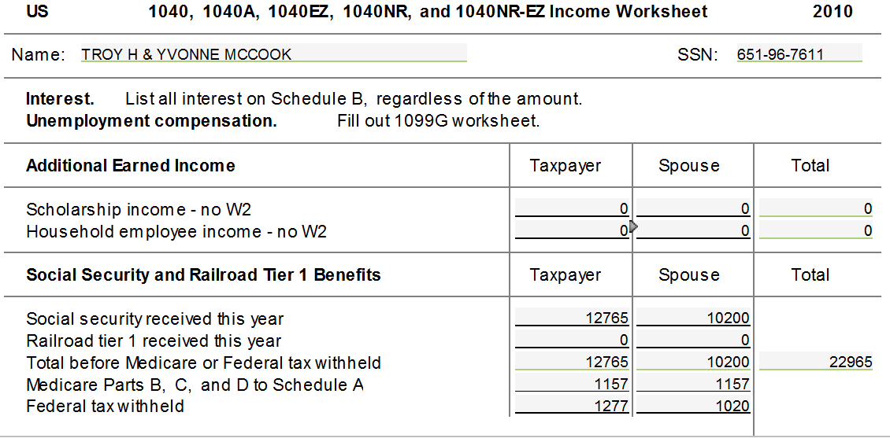
TaxWise Wkt 1
Box 5 From 1099-SSA
Medicare Part B
Box 6 From 1099-SSA

Slide 16
Earned Income Credit
Earned Income Credit
  A refundable tax credit for people who work but do not earn high incomes
  There are requirements that must be met to get this credit ( details later)
  For the familiarization problems, check the EIC box next to the dependents name in the main info sheet and follow the form “Sch EIC” and “ SCH EIC Wkst”questions in TaxWise in the order they are shown

Slide 17
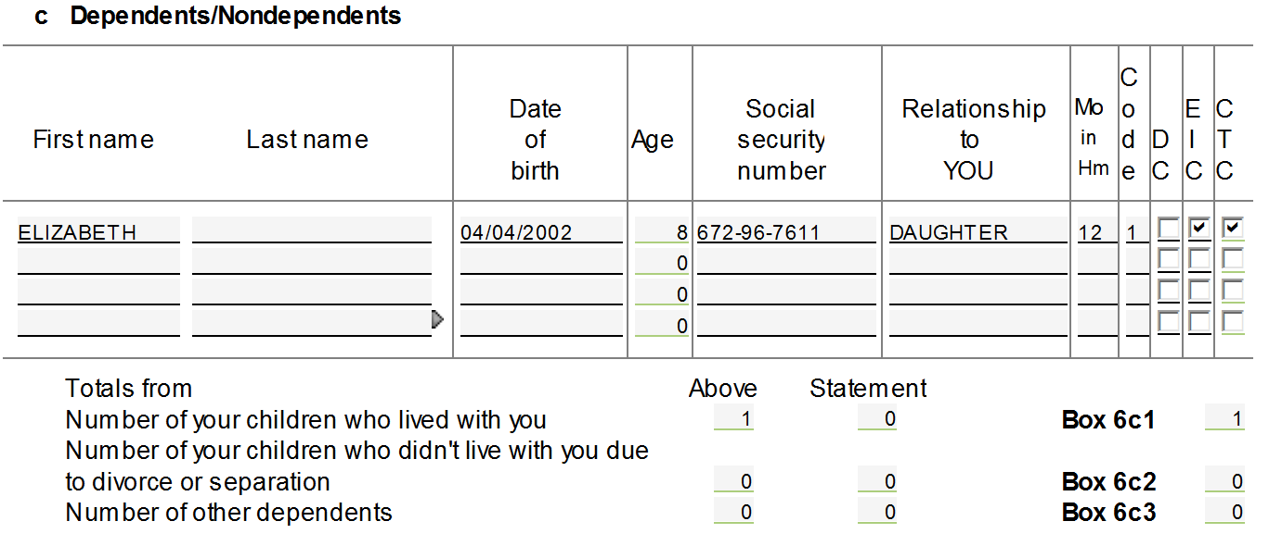
Main Information Sheet Dependents
Check this box

Slide 18
Child Tax Credit
Child Tax Credit
  A nonrefundable credit that allows taxpayers to claim a tax credit per qualifying child
  If not claimed in full, taxpayer may be eligible for refundable Additional Child Tax Credit
  TaxWise automatically calculates this credit
Notes:
Briefly describe what a refundable and nonrefundable credit is.

Slide 19
New Jersey Inputs
Most fields from the Federal Return are copied into the NJ Return by TaxWise
There are differences between Federal & NJ Tax Law. The differences and the TaxWise implications will be discussed later
If the NJ IRA worksheet goes red, leave it as is. NJ IRA worksheet will be discussed later.

